Slide 1
Rockin’ round the Clock
By Marissa Segreto, Sara Popow,
Merilee Robinson

Slide 2
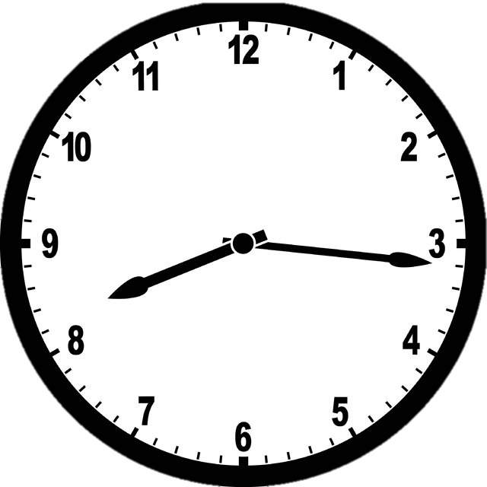
Find the measure of the smaller angle between the hands of a clock at 8:16 am. (Note: in degrees not radians)

Slide 3
Take a minute to think about it...

Slide 4
What should we take into account?
minute hand
hour hand
unit circle
total degrees in a circle

Slide 6
Hint One - minute hand
*notice how many minutes are in one hour and how many minutes are being used
Since there is 16 minutes being used in one hour we can say = 16/60 minutes per hour
Also, there is 360 degrees in a circle and our clock can be represented as a unit circle.
So,
16/60 multiplied by 360 degrees = 96 degrees
Therefore, our minute hand of 16/60 is represented at 96 degrees.

Slide 8
Hint Two- hour hand
*notice the hour between 8 and 9 o’clock and how many minutes have gone by
Since the hour hand is 16 minutes past 8 o’clock we can say = 16/60 minutes per hour
Since there is 12 hours shown on the clock,
between 8 and 9 o’clock can be represented as 1/12.
Also, there is 360 degrees in a circle and our clock can be represented as a unit circle.
So,
16/60 multiplied by 1/12 multiplied by 360 degrees = 8 degrees
Therefore, our hour hand is 8 degrees past 8 o’clock..

Slide 10
Hint Three- hour hand
* 12 to 3 am, 3 to 6 am, 6 to 9 am, 9 to 12 am represent 90 degree angles.
Since, 16/60 multiplied by 1/12 multiplied by 360 degrees = 8 degrees
Therefore, our hour hand is 8 degrees past 8 o’clock..
6 o’clock to 9 o’clock forms a right angle. 6 to 7, 7 to 8, and 8 to 9 would be an equal 30 degrees.
If before the hour hand to 8 o’clock is 8 degrees, then after the hour hand to 9 o’clock is 22 degrees.

Slide 12
Solution
If we take the whole unit circle of 360 degrees and subtract the portions above each the minute and hour hand towards 12 o’clock, we can find the smaller angle between the hands at 8:16 am.
360 - 112 - 96 = 152 degrees

